Slide 1

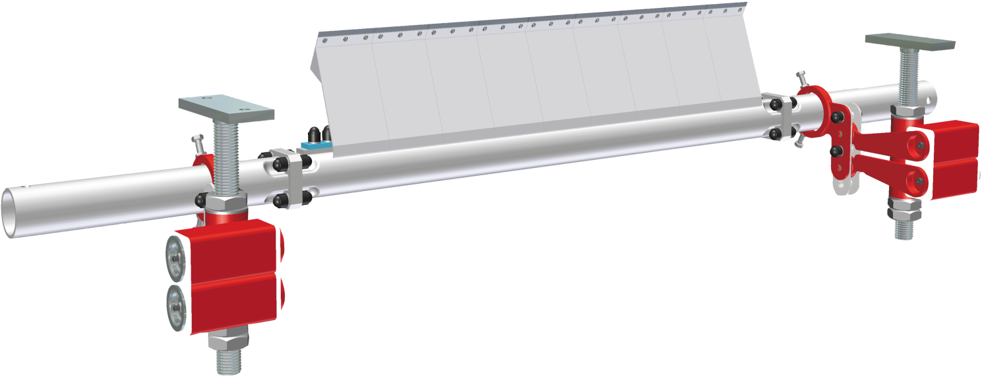
HOSCH Scraper Type B6C Title
HOSCH Scraper Type B6C
©1999 HOSCH
Basic Technical Training - 0300T - 19991029 - EN

Slide 2
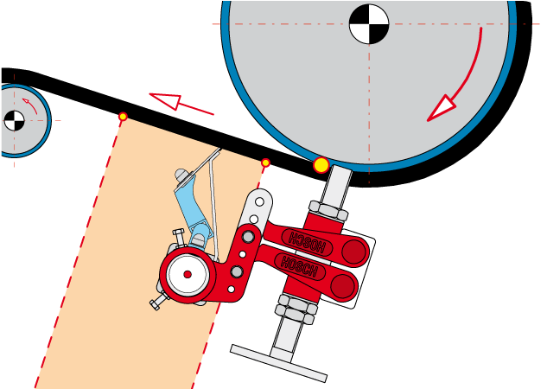
HOSCH
type B6C
SCRAPER
B6C - Series
Single-row main scraper
For medium to heavy duty applications Belt widths from 650 up to 3200 mm
Belt speeds up to 7 m/s Installed off the head pulley / optional drum
©2002 HOSCH
Basic Technical Training - 0301T - 20020201 - EN

Slide 3

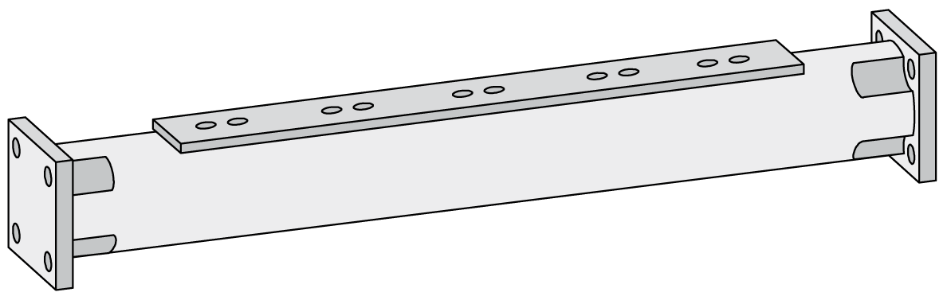


HOSCH Scraper Type B6C
Kit Assembly Carrier
Assembly Carrier
Endsection
Midsection
Endsection
©1999 HOSCH
Basic Technical Training - 0320T - 19991029 - EN

Slide 4
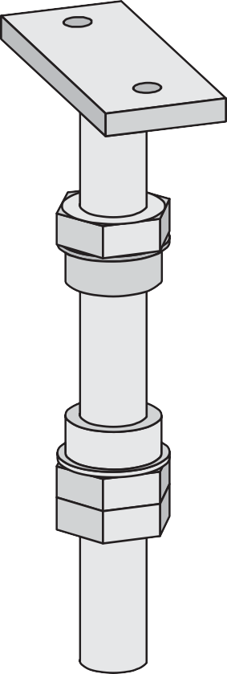

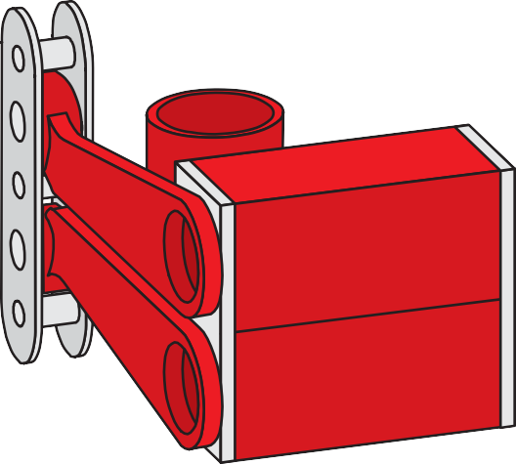
HOSCH Scraper Type B6C Elastomount
Elastomount
Spindle
Elastomount
Locking ring
©1999 HOSCH
Basic Technical Training - 0330T - 19991029 - EN

Slide 5
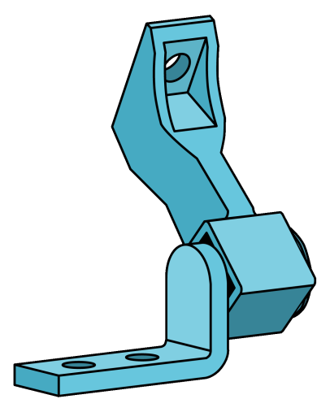
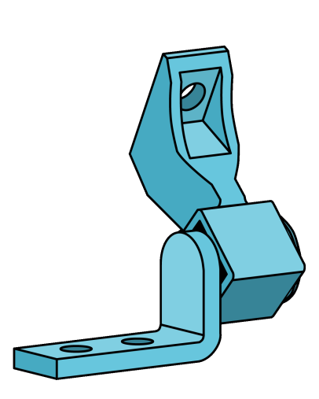
HOSCH Scraper Type B6C Modules
Elements
long
element
short
element
©1999 HOSCH
Basic Technical Training - 0340T - 19991029 - EN

Slide 6

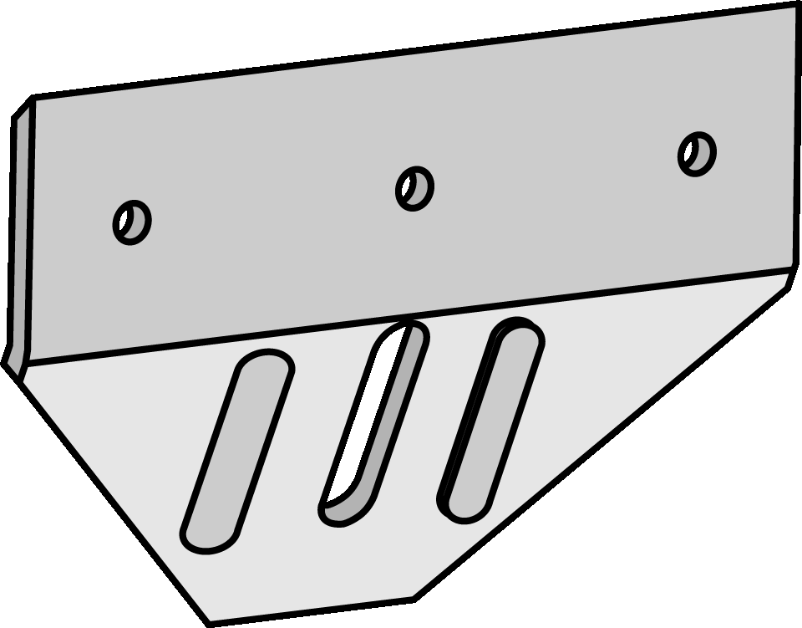
HOSCH Scraper Type B6C Modules
Blades
Z-blade
V-blade
©1999 HOSCH
Basic Technical Training - 0340T - 19991029 - EN

Slide 7
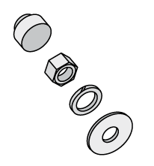
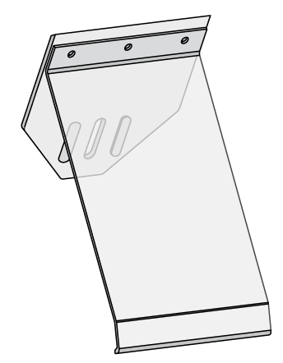
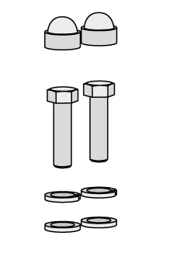
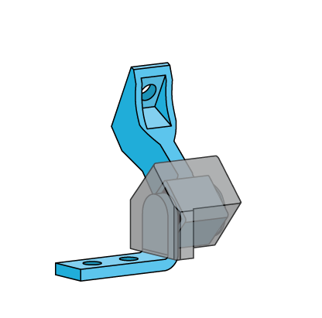
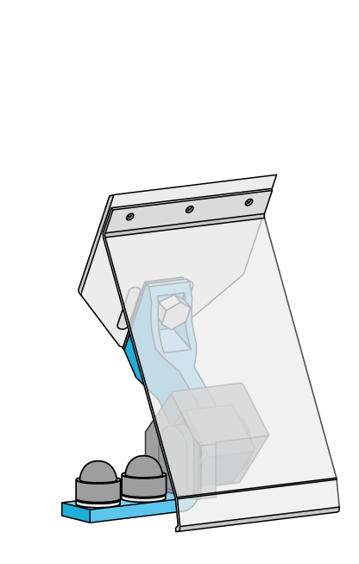
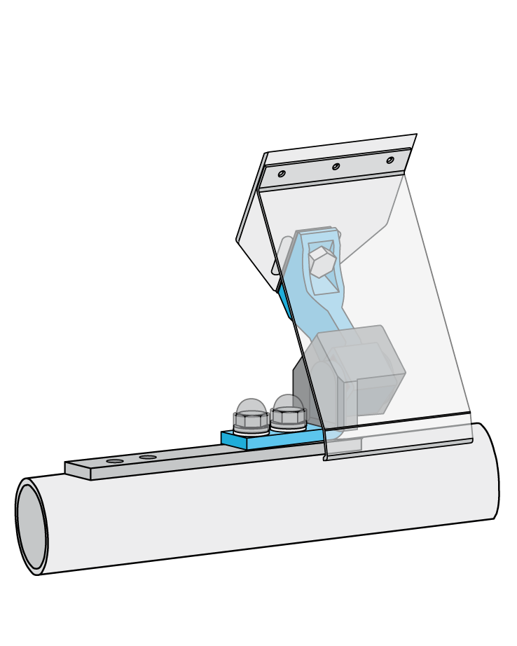


HOSCH Scraper Type B6C Modules
Element & Blades
©1999 HOSCH
Basic Technical Training - 0340T - 19991029 - EN

Slide 8
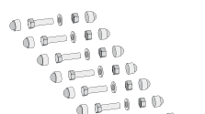
HOSCH Scraper Type B6C Offset
Offset
upwards
downwards
©1999 HOSCH
Basic Technical Training - 0340T - 19991029 - EN

